Slide 1
Session – 17
SAFe Methodology

Slide 2
Scaled Agile Framework (SAFe)
INTRODUCTION
The SAFe framework was introduced in 2011. It was originally called the “Agile Enterprise Big Picture”
The Scaled Agile Framework, or SAFe, methodology is an agile framework for development teams built on three pillars: Team, Program, and Portfolio.

Slide 3
What we Discuss
What is Scaled Agile Framework (SAFe)
Why to use Agile Framework
When to Use Scaled Agile Framework
Foundations of Scaled Agile Framework

Slide 4
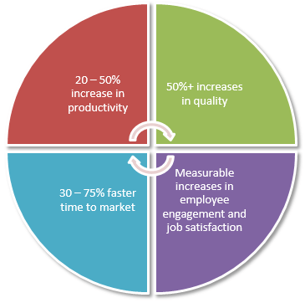
Why to use Agile Framework

Slide 5
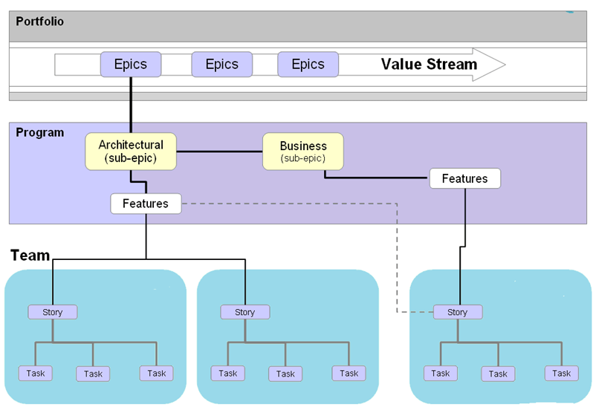
Agile Process Works

Slide 6

When to Use Scaled Agile Framework
•

Slide 7
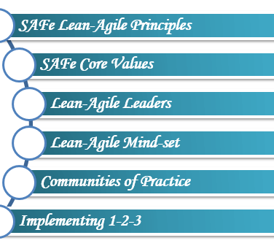
Foundations of Scaled Agile Framework

Slide 8
SAFe Lean-Agile Principles
These basic principles and values for SAFe must be understood, exhibited and continued in order to get the desired results.
• Take an economic view
• Apply systems thinking
• Build incrementally with fast, integrated learning cycles
• Base milestones on an objective evaluation of working systems
• Visualize and limit WIP, reduce batch sizes and manage queue lengths
• Decentralize decision-making

Slide 9
SAFe Agile Core Values
The SAFe agile is based on these four values.
Alignment:
Built-in Quality
Transparency:
Program Execution:

Slide 10
Lean Agile Leaders
The Lean-Agile Leaders are lifelong learners and teachers.
It helps teams to build better systems through understanding and exhibiting the Lean-Agile SAFe Principles.

Slide 11
Lean Agile Mind-Set
Lean-Agile mindset is represented in two things:
The SAFe House of Lean
Agile Manifesto

